Slide 1
A Study Of
The Book Of Revelation
May 17, 2020

Slide 2
Resources used:
A Study Of The Book Of Revelation by Bob Dodson
More Than Conquerors by William Hendriksen
Overcoming With The Lamb, Florida College Annual Lectures, February 7-10, 1994
Revelation: An Introduction and Commentary by Homer Hailey
Revelation (Truth Commentaries) by Robert Harkrider
Revelation (A Study Workbook) by Robert Harkrider
Revelation by Donnie Rader
Studies In The Book Of Revelation by Ferrell Jenkins
The Old Testament In The Book Of Revelation by Ferrell Jenkins
The Revelation Of Saint John The Divine by G.B. Caird
The Book of Revelation by Foy E. Wallace
The Avenging of the Apostles and Prophets by Arthur M. Ogden
Worthy Is The Lamb by Ray Summers
Written exchange on “The Domitian Persecution” between Arthur M. Ogden and Ferrell Jenkins presented in Searching The Scriptures, June 12, 1989, pages 7-12

Slide 3
Revelation 1
“John’s Vision of Christ
Commissioning Him to Write”
John’s Vision of Christ Among the Churches (verses 9-20)
Response of John to the vision. (verses 17-18)
Typical of man in the presence of deity. Genesis 3:8; 17:3; Exodus 3:6; Numbers 22:31; Joshua 5:14; Isaiah 6:5
Note: Ezekiel 1:28; 3:23; 43:3

Slide 4
Revelation 1
“John’s Vision of Christ
Commissioning Him to Write”
John’s Vision of Christ Among the Churches (verses 9-20)
Revelation 1:17, “And he laid his right hand upon me, saying, Fear not …”
Note: The same hand that held the stars could reach in tenderness to tell John to not be afraid. cf. Daniel 10:10-12

Slide 5
Revelation 1
“John’s Vision of Christ
Commissioning Him to Write”
John’s Vision of Christ Among the Churches (verses 9-20)
Revelation 1:17-18, “I am the first and the last, and the Living one; and I was dead, and behold, I am alive for evermore, and I have the keys of death and of Hades.” (cf. 1:8)
Reason for boldness. Matthew 10:28; 1 Corinthians 15:54-55; Isaiah 53
  Clearly a reference to Christ as eternal.
  John 1:1-2; Colossians 1:16-18
  Found 3 times in Revelation: 1:17; 2:8; 22:13

Slide 6
Revelation 1
“John’s Vision of Christ
Commissioning Him to Write”
John’s Vision of Christ Among the Churches (verses 9-20)
Commission to write (verses 11, 19)
To seven churches of Asia Minor.
Explanation of vision (verse 20)
“the mystery of the seven stars which thou sawest in my right hand, and the seven golden candlesticks. The seven stars are the angels of the seven churches: and the seven candlesticks are seven churches.”

Slide 7
Revelation 1
What Is The Point?
“A living, holy, majestic, omniscient, authoritative, powerful Christ stands in the midst of the churches, holds their destiny in his hand and says: ‘Stop fearing, I was dead. I am alive forever. More than that, I hold in my hand the keys of death and the grave. You should not fear to go any place to which I hold the key.’”
– Ray Summers, Worthy is the Lamb, 105

Slide 8
Revelation 2:1-7
Letter to the church at Ephesus

Slide 9
Letters To The Seven Churches
Pattern:
  Salutation.
  Christ’s self-designation.
  Commendation of good.
  Condemnation of evil.
  Warning and threat.
  Exhortation to repent and do the first works.
  Promise of reward if they follow.

Slide 10
Letters To Seven Church of Asia
(Revelation 2-3)
Some were good (Smyrna, Philadelphia)
Some were good / bad (Ephesus, Pergamum, Thyatira, Sardis)
One was bad (Laodicea)

Slide 11
Letters To Seven Church of Asia
(Revelation 2-3)
“I KNOW THY WORKS.” Revelation 2:2, 9, 13, 19, 3:1, 8, 15
  God is not mocked. Galatians 6:7-8, Judgment is coming.
  cf. Romans 2:5-11, 16; 2 Corinthians 5:10
  On the other hand … Revelation 14:13; Hebrews 4:14-16
“TO HIM THAT OVERCOMETH.” (Revelation 2:7, 11, 17, 26; 3:5, 12, 21)
  “Overcome” used 14 times in Revelation, means “victory.”
  Written to encourage. (cf. Matthew 10:28; 16:26)
    Continue steadfastly. (Hebrews 12:1-4; 1 Corinthians 15:58;
    cf. 1 Corinthians 9:27; 10:12; 2 Peter 2:20-22)
  NOTE: These letters would have no meaning if it were not possible to fall. (Revelation 2:5, 16, 22-23; 3:3, 18-19; cf. Hebrews 3:12-14)

Slide 12
Letters To Seven Church of Asia
(Revelation 2-3)
“HE THAT HATH AN EAR, LET HIM HEAR WHAT THE SPIRIT SAITH …” Revelation 2:7, 11, 17, 29; 3:6, 13, 22
  The Lord does not force anyone. Revelation 22:17;
  cf. Romans 6:16
  Though written to “churches,” these instructions are individual in application. cf. Romans 14:12
Note: Sardis was a “dead” church, “… But thou hast a few names in Sardis that did not defile their garments: and they shall walk with me in white; for they are worthy.” Revelation 3:4

Slide 13
Letters To Seven Church of Asia
(Revelation 2-3)
Good
Good/
Bad
Good
Good/
Bad
Bad
Good/
Bad
Good/
Bad
Most of us would like to be in a GOOD church (no condemnation)
None of us would have anything to do with a BAD church (no commendation)
Reality: May be in a church that is GOOD / BAD
(Some commendation and some condemnation)

Slide 14
Revelation 2:1-7
“Letter to the Church at Ephesus”
The Church That Left Its First Love
  Identification of the Author (verse 1)
  Commendation (verses 2-3, 6)
  Condemnation (verse 4)
  Plea to Repent (verse 5)
  Promise if Overcome (verse 7)

Slide 15
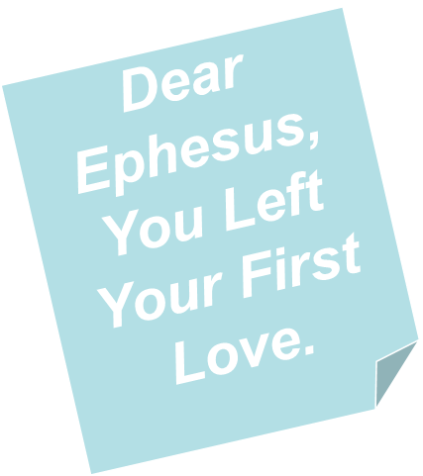

Revelation 2:1-7
“Letter to the Church at Ephesus”
The Church That Left Its First Love
Key Verse
Revelation 2:4
“Nevertheless I have this against you, that you have left your first love.”

Slide 16
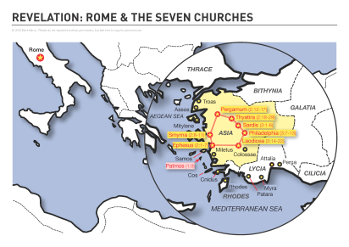
E
P
H
E
S
US
Third largest city of Roman empire.
Population 250,000.
One of the greatest seaports in the ancient world.

Slide 17
Revelation 2:1-7
Lord Sees and Knows It All
Verse 1: “To the angel of the church in Ephesus write: These things saith he that holdeth the seven stars in his right hand, he that walketh in the midst of the seven golden candlesticks.”
What is said (good / bad) is stated by one who holds the destiny of the church in his hand.
Lord has full knowledge of the inner-workings of this church!

Slide 18
Revelation 2:1-7
A Church That Left Its First Love
When the Fire is Gone
Its History

Slide 19
Revelation 2:1-7
Its History
Paul Visited Ephesus Briefly on 2nd Journey (Acts 18:18-21)
Aquila and Priscilla Corrected Apollos (Acts 18:24-28)
Conversion of 12 Previously Baptized (Acts 19:1-7)
Many Converted on 3rd Journey (Acts 19:8-20)
  In midst of controversy (verses 8-16)
  Burned their books (verses 18-19)
  Stayed three years (Acts 20:31)

Slide 20
Revelation 2:1-7
Its History
Idol Craftsmen Caused a Riot. (Acts 19:21-41)
Paul Met with Elders at Miletus. (Acts 20:13-38)
May have Visited Again after Prison. (1 Timothy 1:3)
Paul Wrote a Letter to Church at Ephesus. (Ephesians)
Timothy Worked with the Church. (1 Timothy 1:3)

